Slide 1
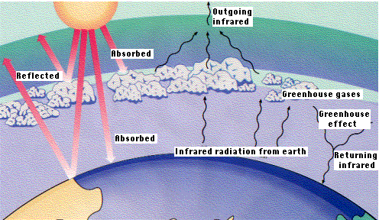
Layer Model

Slide 2
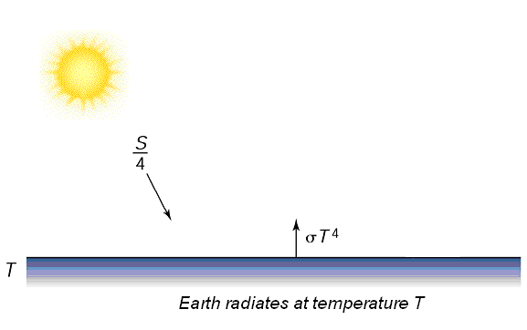

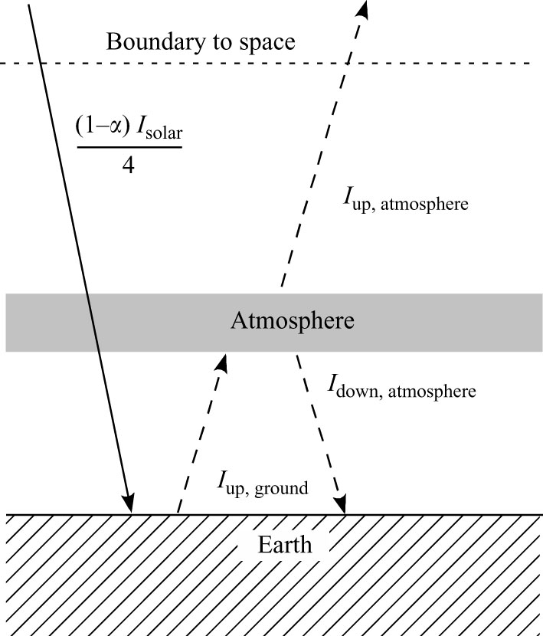
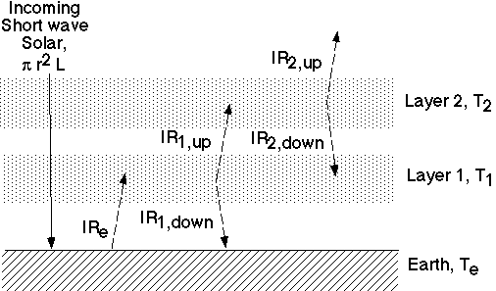
Assumption: energy in = energy out
F_{in} = F_{out}
T = -6⁰C Too cold
Albedo = reflected light = α = 30%
T = -18⁰C Too cold
T _{earth} = 4 (1 - α) I_{in}
4εσ
T_{ground} = 2T_{atm}
4
T = 30⁰C Too warm
T_{ground} = 1.19 T_{atm}
T_{ground} = 3T_{atm}
T = 65⁰C Too hot
4

Slide 3
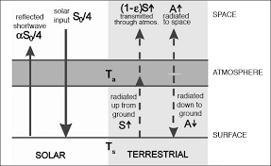
Leaky Green House Layer:
Absorptivity of atmosphere: ε
0<ε1
ε = 0…….?????
ε = 1…….?????

Slide 4







Leaky Green House Layer:
Net flux at the top of atm:
F_{in} = F_{out}
Net flux at the surface:

Slide 5


Leaky Green House Layer:
T = 303⁰k
Real situation:
Partial transparency of IR radiation or leaky green house effect
For ε= 0.78 , T_{s}=1.131T_{e}=288⁰k

Slide 6
Atm is not an energy source like a giant heat lamp in the sky.
So, how does it change the T of the ground??
Analogy: Equilibrium water level in a steadily filling/draining sink.
1. Water flows in, hangs out awhile, drain out.
energy in = energy out
2. Drains faster as the level rises due to inc. pressure (weight).
energy flows out faster as T rises
3. Eventually water level gets to a point where flow out equals flow in.
This is the equlibrium T
Sink
Water Level
Drain

Slide 7
4. Now, constrict the drain with a penny.
Water flows out more slowly,
Sink
Drain
Constrict flow

Slide 8
4. Now, constrict the drain with a penny.
Water flows out more slowly,
The water level rises …..
But upto which height???
until the higher water level pushes more water down drain to balance the flow from the faucet again.
Greenhouse gases are the ‘penny in the drain’.
They make it more difficult for heat to
escape the Earth,
and as a result the equilibrium temperature has to go up until
the fluxes balance each other again.
Sink
Water Level Rises
Drain
Constrict flow

